Slide 1
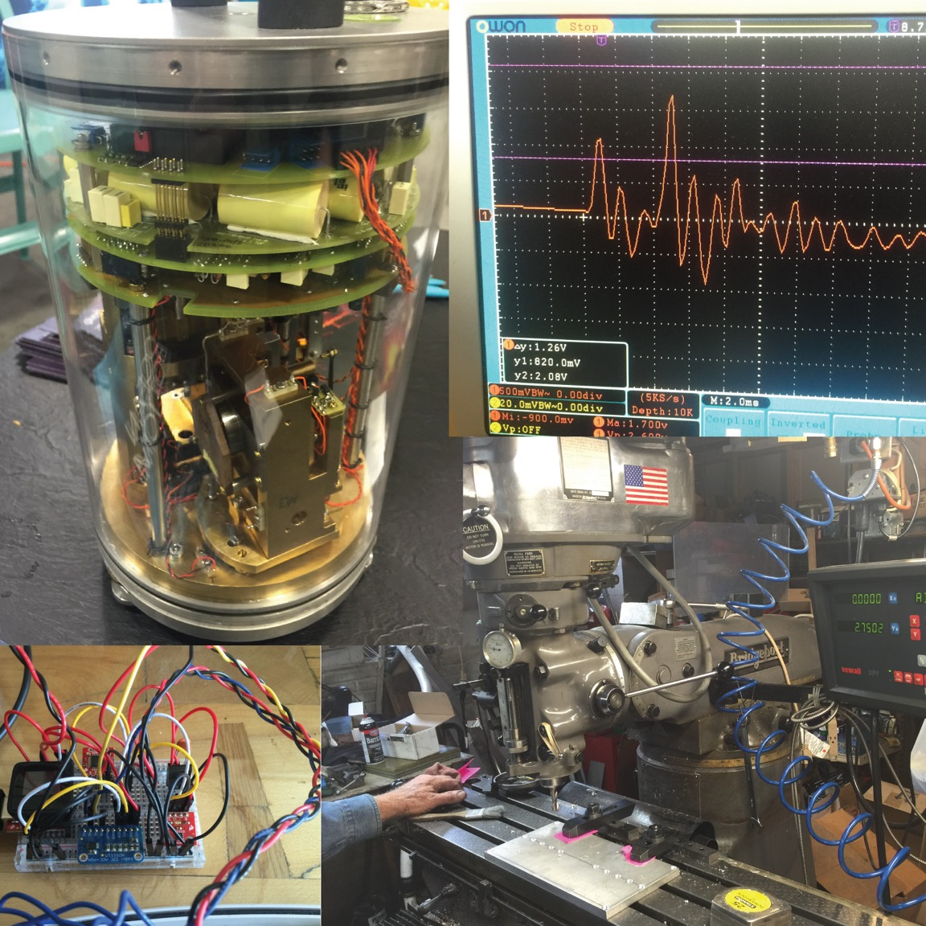
Course Introduction and Arduino Setup
Chris Marone & Clay Wood
Techniques of Geophysical
Experimentation
20 Jan 2021

Slide 2
Please read the syllabus and lecture plans! This is a hands on class that requires participation
Course Goals
1. To learn how to design and build basic mechanical and electrical devices for laboratory measurement work.
2. Gain hands-on experience using real equipment, sensors, and machines with particular focus on the Biaxial deformation machine in the Rock Mechanics Lab
Exercises | 50%
Final Project | 40%
Class Participation | 10%
Notes:
Theory is when you know everything, but nothing works. Practice is when everything works, but no one knows why. In our lab, theory and practice are combined: nothing works and no one knows why.

Slide 3
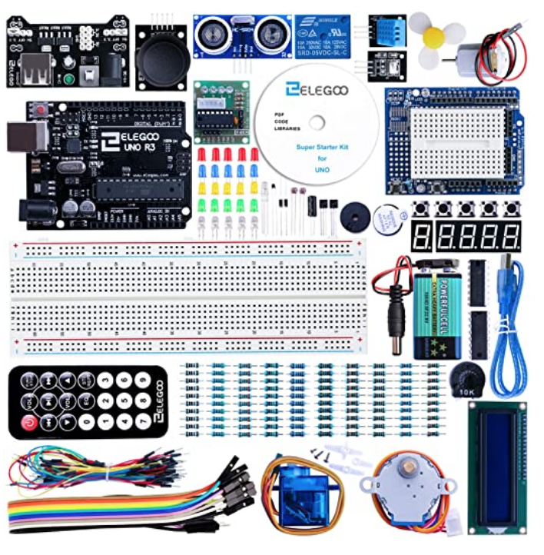
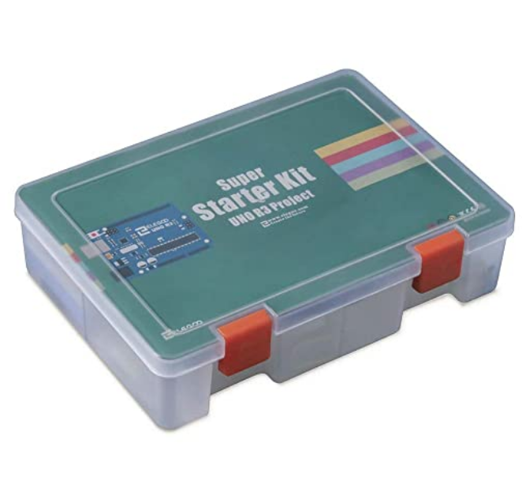
Bring your ELEGOO Kit and Laptop to every class
ELEGOO UNO Project Super Starter Kit with Tutorial and UNO R3 Compatible with Arduino IDE
Notes:
Theory is when you know everything, but nothing works. Practice is when everything works, but no one knows why. In our lab, theory and practice are combined: nothing works and no one knows why.

Slide 4
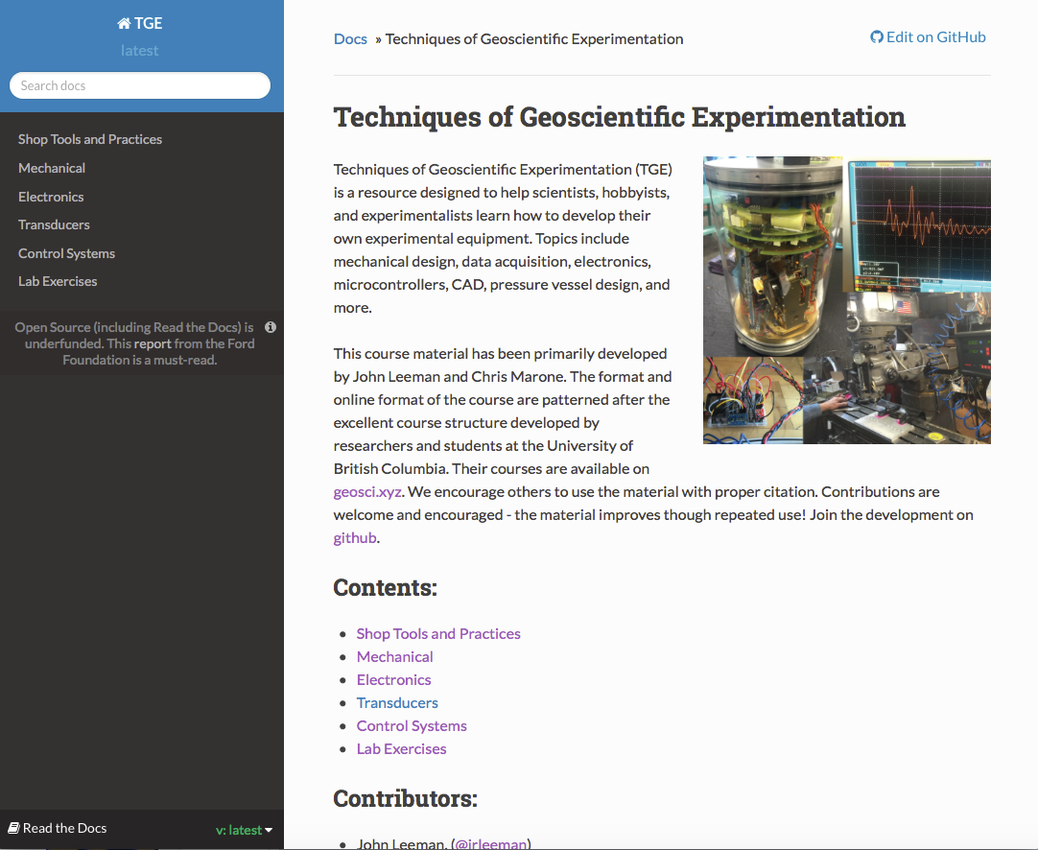
We’ll use Canvas, Github and also this resource: https://tge.readthedocs.io
Bookmark this website
Notes:
Theory is when you know everything, but nothing works. Practice is when everything works, but no one knows why. In our lab, theory and practice are combined: nothing works and no one knows why.

Slide 5
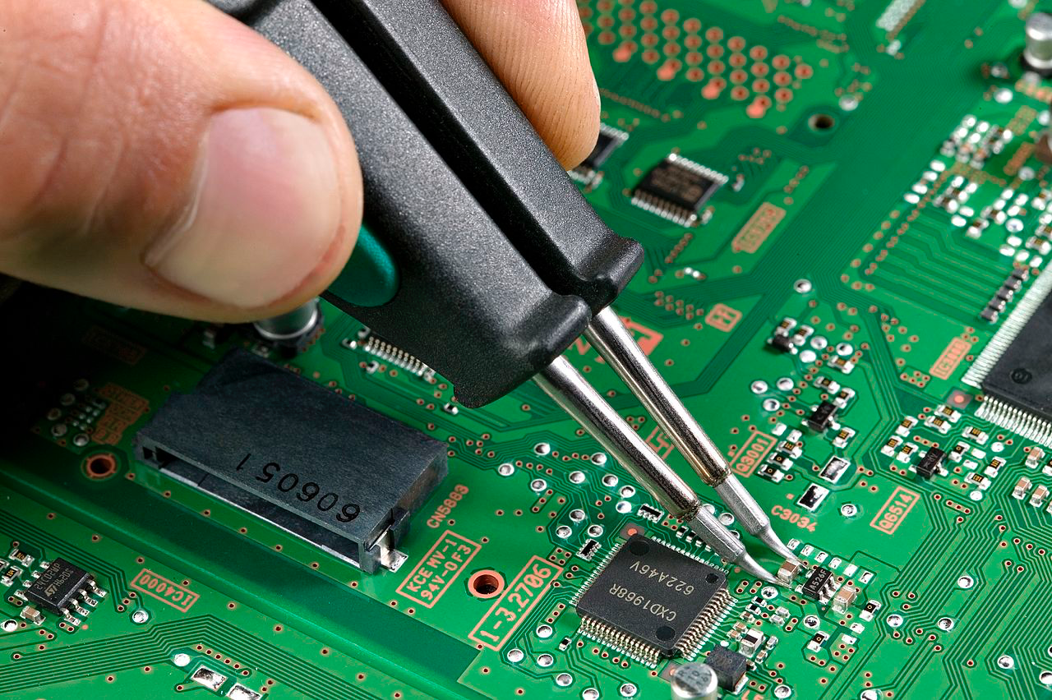
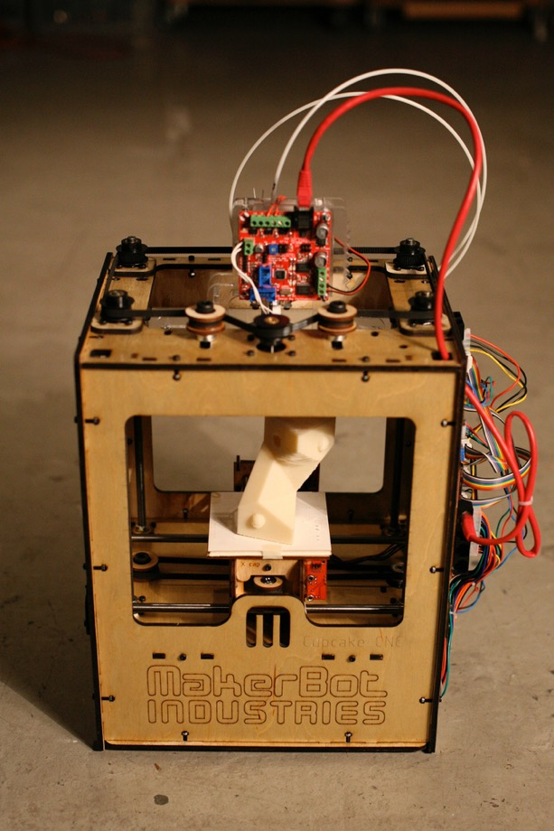
A key part of the course is a semester long project
Images: wikipedia.com
- Uses multiple disciplines we discuss (i.e. mechanical, electrical, software, etc.)
- Solves a problem with no commercial solution or no economical commercial solution.
- Will not cost thousands of dollars to build
- Does not put you or others in the path of potential harm or danger.
Notes:
Theory is when you know everything, but nothing works. Practice is when everything works, but no one knows why. In our lab, theory and practice are combined: nothing works and no one knows why.

Slide 6
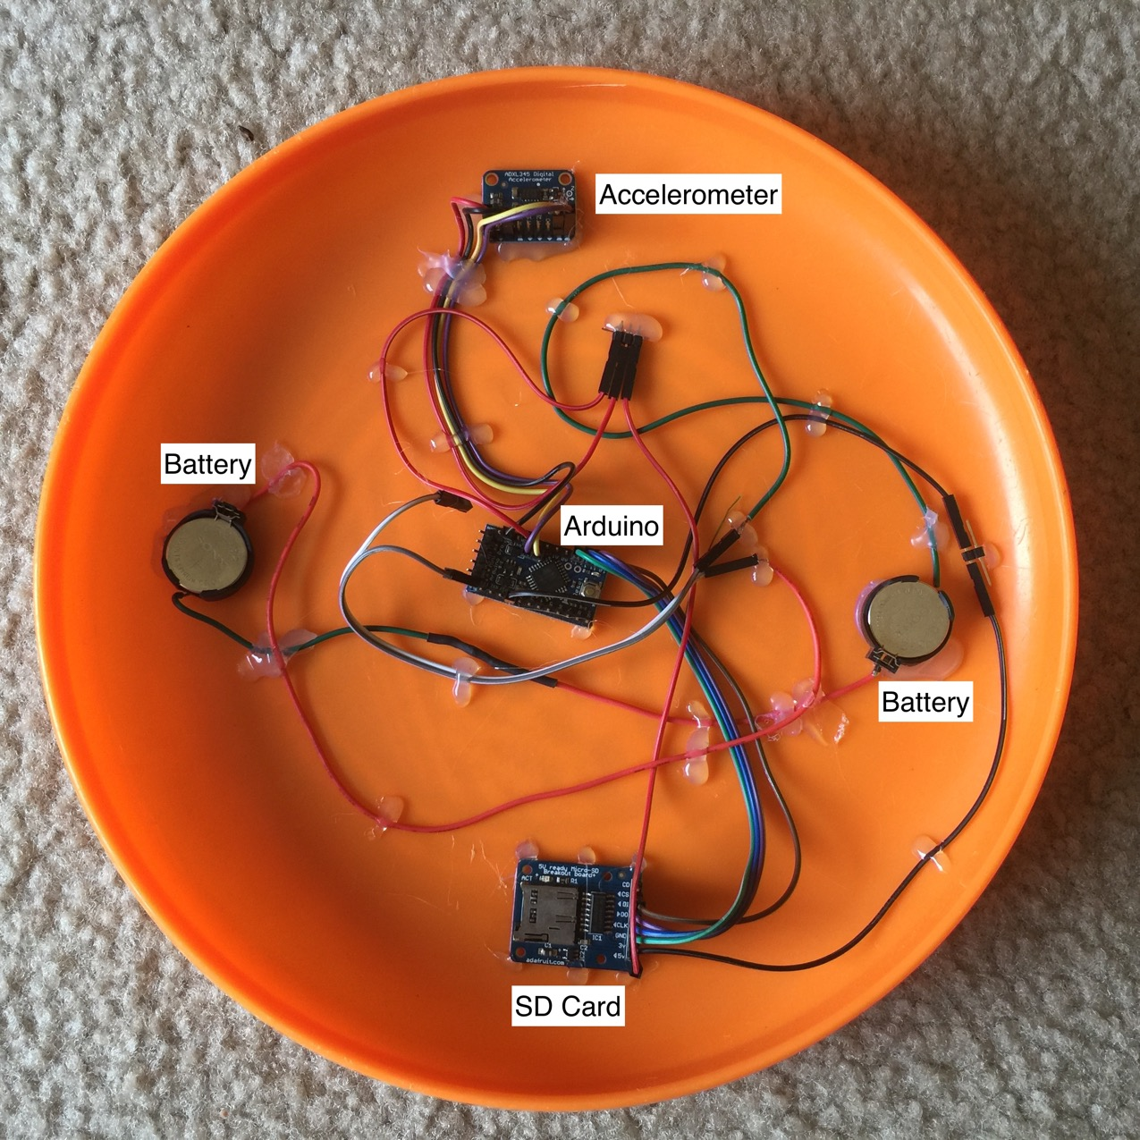
A few example projects
Notes:
Theory is when you know everything, but nothing works. Practice is when everything works, but no one knows why. In our lab, theory and practice are combined: nothing works and no one knows why.

Slide 7
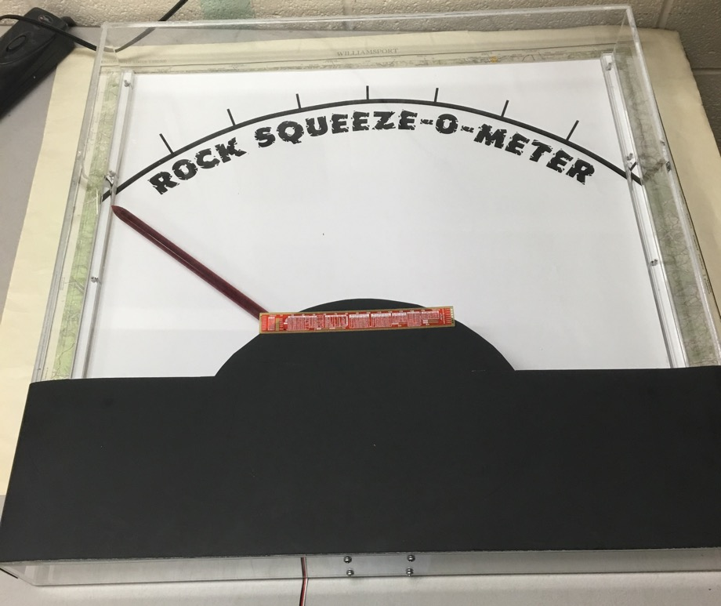
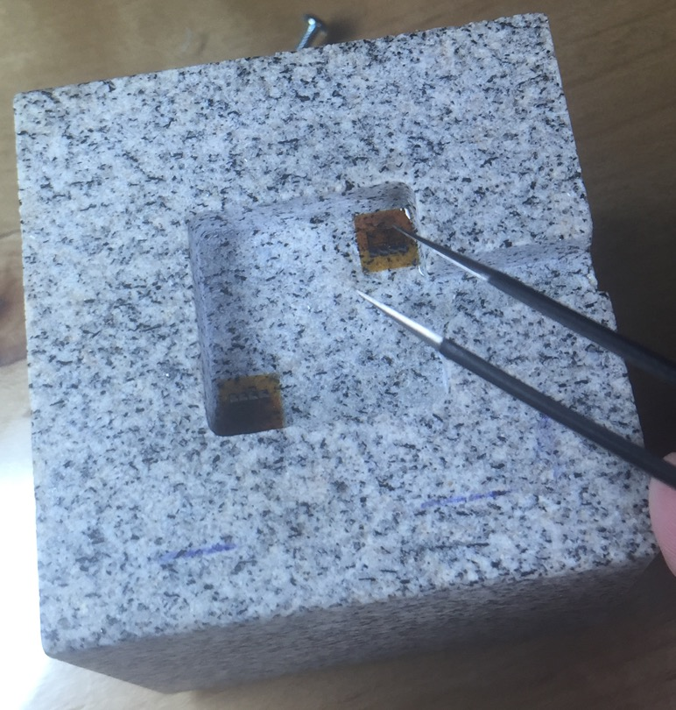
A few example projects
Notes:
Theory is when you know everything, but nothing works. Practice is when everything works, but no one knows why. In our lab, theory and practice are combined: nothing works and no one knows why.

Slide 8
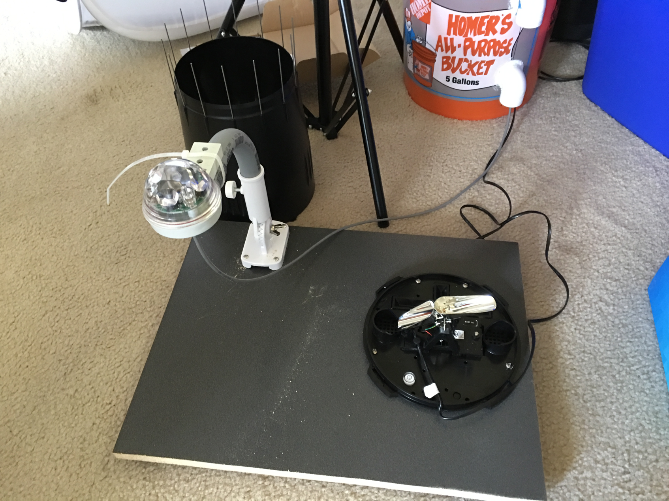
A few example projects
Notes:
Theory is when you know everything, but nothing works. Practice is when everything works, but no one knows why. In our lab, theory and practice are combined: nothing works and no one knows why.

Slide 9
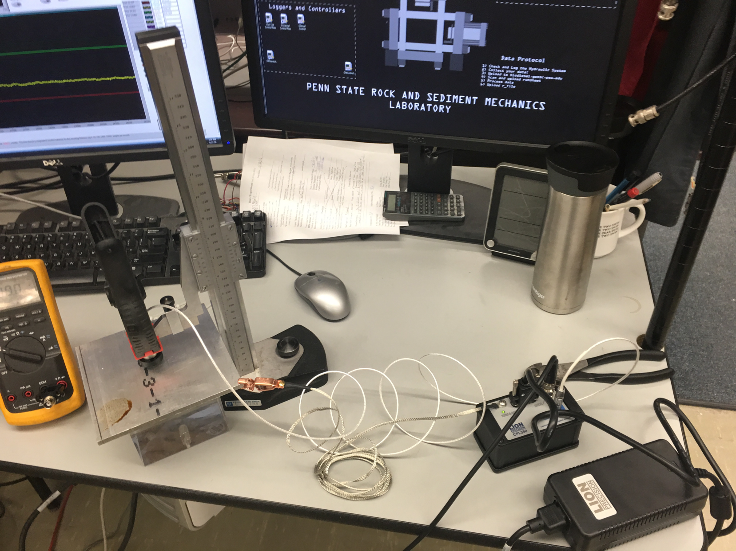
A few example projects
Notes:
Theory is when you know everything, but nothing works. Practice is when everything works, but no one knows why. In our lab, theory and practice are combined: nothing works and no one knows why.

Slide 10
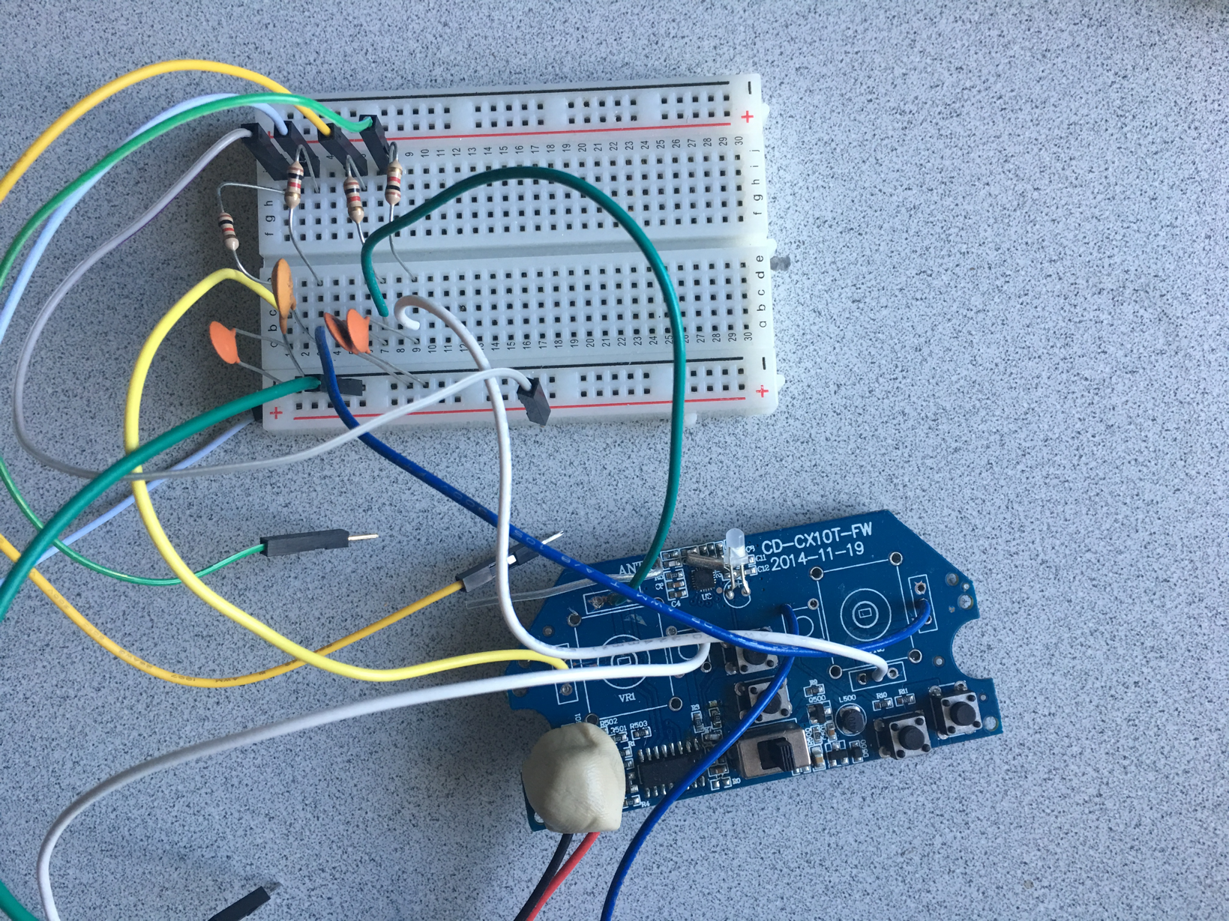
A few example projects
Notes:
Theory is when you know everything, but nothing works. Practice is when everything works, but no one knows why. In our lab, theory and practice are combined: nothing works and no one knows why.

Slide 11
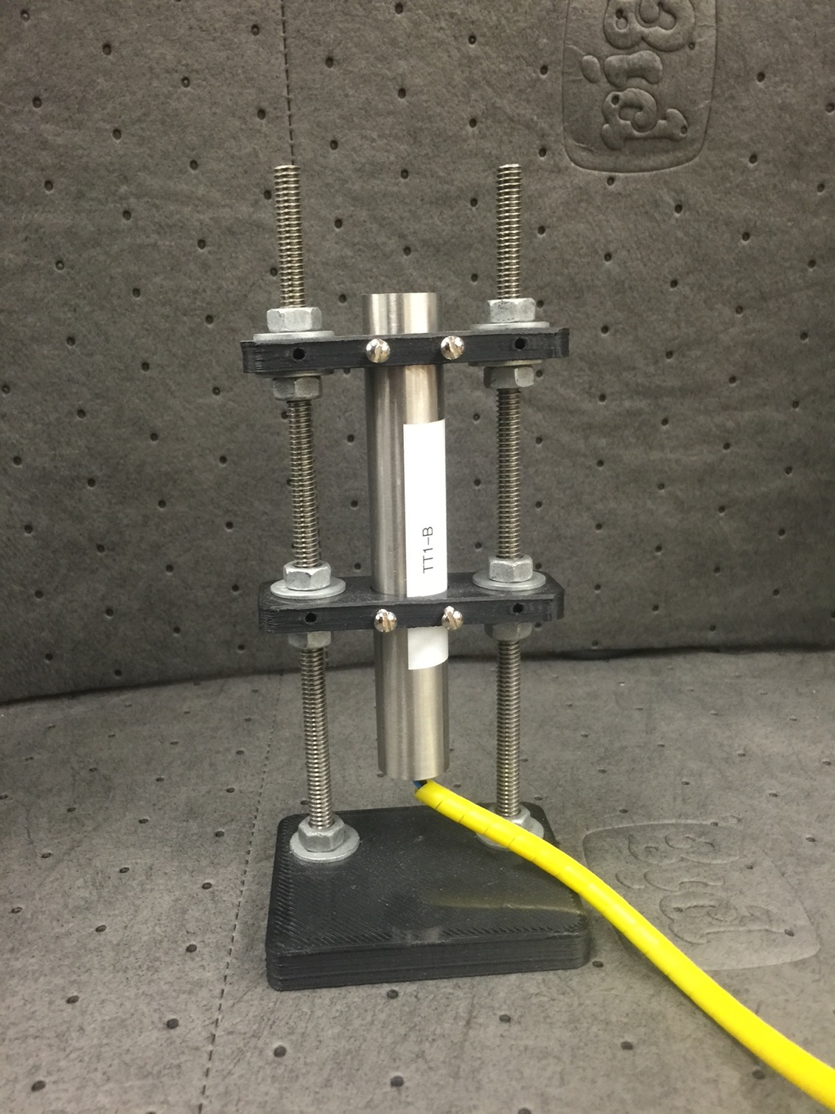
A few example projects
Notes:
Theory is when you know everything, but nothing works. Practice is when everything works, but no one knows why. In our lab, theory and practice are combined: nothing works and no one knows why.

Slide 12
Sources of inspiration are everywhere
Notes:
Theory is when you know everything, but nothing works. Practice is when everything works, but no one knows why. In our lab, theory and practice are combined: nothing works and no one knows why.

Slide 13
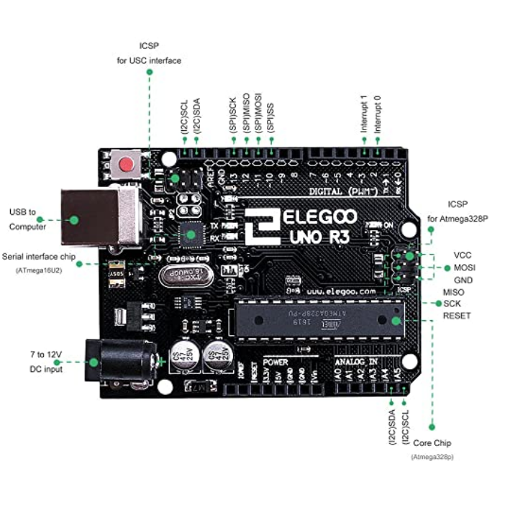
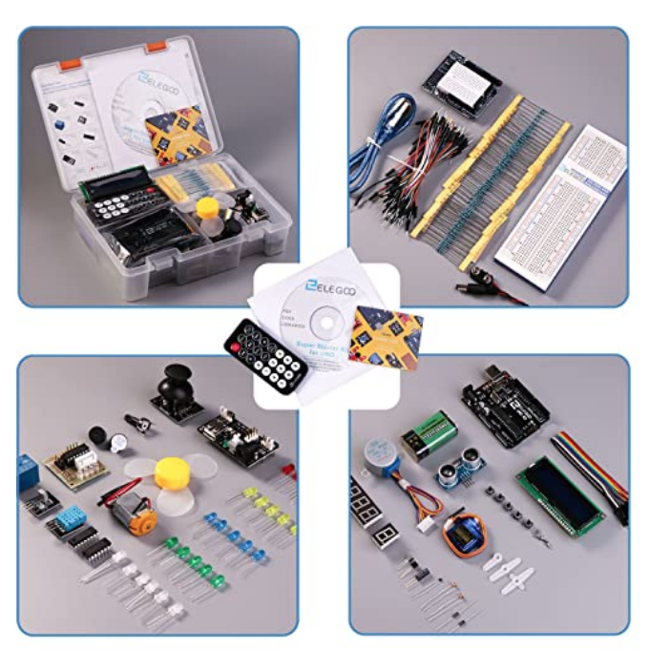
Let’s dig into the kit and see what you have
Notes:
Theory is when you know everything, but nothing works. Practice is when everything works, but no one knows why. In our lab, theory and practice are combined: nothing works and no one knows why.

Slide 14
Activity: Blinky --Let’s do it now
https://www.arduino.cc/en/Tutorial/BuiltInExamples/Blink
Notes:
Theory is when you know everything, but nothing works. Practice is when everything works, but no one knows why. In our lab, theory and practice are combined: nothing works and no one knows why.

Slide 15
Activity due next week: Stoplight
https://www.instructables.com/Arduino-Street-Traffic-Light/
Submit your code via Canvas
Notes:
Theory is when you know everything, but nothing works. Practice is when everything works, but no one knows why. In our lab, theory and practice are combined: nothing works and no one knows why.

